Slide 1
Transparency Masters for
Chapter 4 of
Data Structures via C++
Objects by Evolution
A. Michael Berman
Copyright © 1997
Oxford University Press
All Rights Reserved

Slide 2
Code Example 4-1: Patient Waiting Times
// cx4-1.cpp
// Code Example 4-1: Patient Waiting Times
#include <iostream.h>
// Somehow, the type "Time" gets defined up here
int main()
{
int numberOfVisits(0), totalWaitingTime(0);
char answer;
do {
Time arrival, seenByDoctor;
cout << "Enter arrival time:";
cin >> arrival;
cout << "Enter time seen by doctor:";
26年 11月 8日
Copyright © 1997 Oxford University Press
All Rights Reserved

Slide 3
Code Example 4-1: Patient Waiting Times
cin >> seenByDoctor;
numberOfVisits++;
// assume that subtracting one Time from another yields the
// difference in minutes as an int
totalWaitingTime += seenByDoctor - arrival;
cout << "Done? Enter 'y' to quit, anything else to continue: ";
cin >> answer;
} while (answer != 'y');
cout << "Number of visits: " << numberOfVisits << "\n";
cout << "Total waiting time: " << totalWaitingTime << " minutes.\n";
cout << "Average wait is " << totalWaitingTime/numberOfVisits
<< " minutes.\n";
return 0;
}
26年 11月 8日
Copyright © 1997 Oxford University Press
All Rights Reserved

Slide 4
Sample Input and Output from
Patient Waiting Times Program
  Enter arrival time: 12:17PM
  Enter time seen by doctor: 12:25PM
  Done? Enter 'y' to quit, anything else to continue: .
  Enter arrival time: 1:10PM
  Enter time seen by doctor: 2:02PM
  Done? Enter 'y' to quit, anything else to continue: y
  Number of visits: 2
  Total waiting time: 60 minutes.
  Average wait is 30 minutes.
26年 11月 8日
Copyright © 1997 Oxford University Press
All Rights Reserved

Slide 5
Goal for Specifying Data
Abstract
  abstract crucial features
safe
  safe manipulation of the data
modifiable
  easy modification
reusable
  reusability
26年 11月 8日
Copyright © 1997 Oxford University Press
All Rights Reserved

Slide 6
Definition 4-1: Abstract Data Type
  An Abstract Data Type, or ADT, is a well-specified collection of data and a group of operations that can be performed upon the data. The ADT’s specification describes what data can be stored (the characteristics of the ADT), and how it can be used (the operations), but not how it is implemented or represented in the program.
26年 11月 8日
Copyright © 1997 Oxford University Press
All Rights Reserved

Slide 7
Definition 4-2
  The program that uses an ADT is referred to as a client of that ADT.
26年 11月 8日
Copyright © 1997 Oxford University Press
All Rights Reserved

Slide 8
Figure 4-1: Two Views of an ADT, using Time ADT as an example
Time ADT
readTime
int minutes
subtractTimes
Implementor’s View
Client’s View
(implementation details visible here)
(only the operations visible here)
26年 11月 8日
Copyright © 1997 Oxford University Press
All Rights Reserved

Slide 9
Definition 4-3
  The principle that a client can use an ADT with no knowledge of its implementation is called Information Hiding.
26年 11月 8日
Copyright © 1997 Oxford University Press
All Rights Reserved

Slide 10
Definition 4-4
  When a programming language allows the creation of an ADT in which the client has no access to the underlying implementation, we say that the language supports encapsulation.
When you learn to use a new class, use the documentation for the class not its implementation
When you create your own classes, you will have an obligation to provide documentation so that others can use them without examining the implementation
26年 11月 8日
Copyright © 1997 Oxford University Press
All Rights Reserved

Slide 11
Code Example 4-4: A class declaration for the Time ADT
// cx4-4.h
// Code Example 4-4: Definition of Time Class
#include "dslib.h"
class Time {
public:
void readTime(bool & errorFlag);
int subtractTimes(Time t);
private:
int minutes;
};
26年 11月 8日
Copyright © 1997 Oxford University Press
All Rights Reserved

Slide 12
Code Example 4-5: Full definition file for Time ADT
// cx4-5.h
// Code Example 4-5: full definition of class Time
#include "dslib.h" // standard header file for this book
class Time {
//
// Characteristics:
//
// A Time consists of some number of hours and minutes, and is either before noon
// (AM) or after noon (PM).
//
// Twelve Noon is 12:00 PM and Twelve Midnight is 12:00 AM.
//
// All Times are assumed to fall on the same day.
//
26年 11月 8日
Copyright © 1997 Oxford University Press
All Rights Reserved

Slide 13
Code Example 4-5: Full definition file for Time ADT
public:
void readTime(bool & errorFlag);
// Precondition: Standard input has characters available.
// Postconditions: Leading whitespace characters are ignored;
// readTime attempts to read, from standard input, a time in
// the format <HH>:<MM><A>, where <HH> is an integer between
// 1 and 12, <MM> is an integer between 0 and 59, and <A> is
// either "AM" or "PM". If a properly formatted time can be
// read, errorFlag is set to false, and the value of the Time
// variable is set to the time read; otherwise, errorFlag is
// set to true.
26年 11月 8日
Copyright © 1997 Oxford University Press
All Rights Reserved

Slide 14
Code Example 4-5: Full definition file for Time ADT
int subtractTimes(Time t);
// Precondition: This Time variable contains a proper value.
// Postcondition: None.
// Returns: The difference, in minutes, between this Time and Time t.
// If this Time occurs prior to Time t, the returned difference
// is negative.
// **** the rest of the class declaration is private
private:
int minutes;
};
26年 11月 8日
Copyright © 1997 Oxford University Press
All Rights Reserved

Slide 15
ADT 4-2: Time ADT revised consistent with Class syntax
(Part 1 of 3)
  Characteristics:
  A Time consists of some number of hours and minutes, and is either before noon (AM) or after noon (PM).
  Twelve Noon is 12:00 PM and Twelve Midnight is 12:00 AM.
  All Times are assumed to fall on the same day.
26年 11月 8日
Copyright © 1997 Oxford University Press
All Rights Reserved

Slide 16
ADT 4-2: Time ADT revised consistent with Class syntax
(Part 2 of 3)
  Operations
    void readTime(bool & errorFlag)
    Precondition: Standard Input has characters available.
    Postconditions: Leading whitespace characters are ignored; readTime attempts to read, from standard input, a time in the format <HH>:<MM><A>, where <HH> is an integer between 1 and 12, <MM> is an integer between 0 and 59, and <A> is either “AM” or “PM”. If a properly formatted time can be read, errorFlag is set to false; otherwise, errorFlag is set to true.
    Returns: If errorFlag is false, the value of this Time is the time read from Standard Input; otherwise, the value of this Time remains unchanged.
26年 11月 8日
Copyright © 1997 Oxford University Press
All Rights Reserved

Slide 17
ADT 4-2: Time ADT revised consistent with Class syntax
(Part 3 of 3)
  int subtractTimes(Time t1)
  Precondition: t1 is well-defined.
  Postcondition: None.
  Returns: The difference, in minutes, between this Time and Time t1; that is, this Time - t1. If this Time occurs before Time t1, this difference is negative.
26年 11月 8日
Copyright © 1997 Oxford University Press
All Rights Reserved

Slide 18
Code Example 4-6: Patient Waiting Times program, revised for C++ Class notation
// cx4-6.cpp
// Patient Waiting Times program, revised for C++ Class notation
#include <iostream.h>
#include "cx4-5.h"
int main()
{
int numberOfVisits(0), totalWaitingTime(0);
char answer;
do {
bool errorFlag; // arrival, seenByDoctor are instances of Time class
Time arrival, seenByDoctor;
cout << "Enter arrival time:";
arrival.readTime(errorFlag);
26年 11月 8日
Copyright © 1997 Oxford University Press
All Rights Reserved

Slide 19
Code Example 4-6: Patient Waiting Times program, revised for C++ Class notation
while (errorFlag) {
cout << "Arrival time was incorrectly formatted; try again: ";
arrival.readTime(errorFlag);
}
cout << "Enter time seen by doctor:";
seenByDoctor.readTime(errorFlag);
while (errorFlag) {
cout << "Seen by doctor time was incorrectly formatted; try again: ";
seenByDoctor.readTime(errorFlag);
}
numberOfVisits++;
26年 11月 8日
Copyright © 1997 Oxford University Press
All Rights Reserved

Slide 20
Code Example 4-6: Patient Waiting Times program, revised for C++ Class notation
// assume that subtracting one Time from another yields the
// difference in minutes as an int
totalWaitingTime += seenByDoctor.subtractTimes(arrival);
cout << "Done? Enter 'y' to quit, anything else to continue: ";
cin >> answer;
} while (answer != 'y');
cout << "Number of visits: " << numberOfVisits << "\n";
cout << "Total waiting time: "<< totalWaitingTime << " minutes.\n";
cout << "Average wait is " << totalWaitingTime/numberOfVisits
<< " minutes.\n";
return 0;
}
26年 11月 8日
Copyright © 1997 Oxford University Press
All Rights Reserved

Slide 21
Code Example 4-7: Implementation of the Time Class
// cx4-7.cpp
// Code Example 4-7: Implementation of the Time Class
#include "cx4-5.h"
void Time::readTime(bool & errorFlag)
{
// The time must be formatted as <HH>:<MM><AMorPM>, where
// <HH> is an int in the range 0 to 12, <MM> is an int in
// the range 0 to 59, and <AMorPM> is either AM or PM.
enum AM_PM {AM, PM} AM_or_PM;
int hour, minute;
const char delimiter = ':';
// Assume that the format is bad -- once valid data is extracted,
// reset errorFlag to false
26年 11月 8日
Copyright © 1997 Oxford University Press
All Rights Reserved

Slide 22
Code Example 4-7: Implementation of the Time Class
errorFlag = true;
// formatted input -- fail if not an int
if (!(cin >> hour))
return;
if (hour < 0 || hour > 12)
return;
char c;
cin >> c;
if (c != delimiter)
return;
if (!(cin >> minute)) // formatted input
return;
if (minute < 0 || minute > 59)
return;
26年 11月 8日
Copyright © 1997 Oxford University Press
All Rights Reserved

Slide 23
Code Example 4-7: Implementation of the Time Class
cin >> c;
if (c == 'A' || c == 'a')
AM_or_PM = AM;
else if (c == 'P' || c == 'p')
AM_or_PM = PM;
else
return;
cin >> c;
if (c != 'M' && c != 'm')
return;
errorFlag = false;
26年 11月 8日
Copyright © 1997 Oxford University Press
All Rights Reserved

Slide 24
Code Example 4-7: Implementation of the Time Class
if (hour == 12)
minutes = minute;
else
minutes = hour*60 + minute;
if (AM_or_PM == PM)
minutes += 60*12;
}
int Time::subtractTimes(Time t)
{
return minutes - t.minutes;
}
26年 11月 8日
Copyright © 1997 Oxford University Press
All Rights Reserved

Slide 25
실습예제
Patient waiting time 프로그램을 복사하여 프로젝트로 구성하여 컴파일과 실행해본다
trace 를 이용해서 프로그램 동작을 살펴본다
Addtime 을 추가한다
Main 함수 끝부분에 환자 도착 시간을 입력받고 평균대기시간을 Addtime을 이용해서 더해서 진료시간을 예측하는 것을 출력한다
26年 11月 8日
Copyright © 1997 Oxford University Press
All Rights Reserved

Slide 26
Transparency Masters for
Chapter 5 of
Data Structures via C++
Objects by Evolution
A. Michael Berman
Copyright © 1997
Oxford University Press
All Rights Reserved

Slide 27
Good Algorithm
How fast
How much memory
Analysis of algorithm
  Compare algorithm, not program
  Critical operations
  rate of growth
26年 11月 8日
Copyright © 1997 Oxford University Press
All Rights Reserved

Slide 28
Definition 5-1
The asymptotic efficiency of an algorithm describes the relative efficiency of an algorithm as n gets very large.
For instance, f(n)=n² + n is order of n²
Best Case, worst case, average case
  average case analysis requires good knowledge of probability theory
26年 11月 8日
Copyright © 1997 Oxford University Press
All Rights Reserved

Slide 29
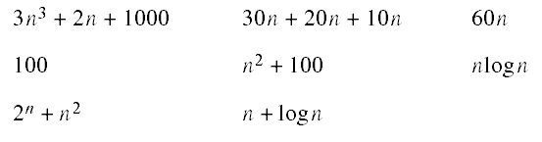
Exercise
  5-2 Rank the asymptotic orders of the following functions, from highest to lowest. (You may wish to graph some or all of them.)
26年 11月 8日
Copyright © 1997 Oxford University Press
All Rights Reserved

Slide 30
Figure 5-1: Sample record format
key
data
26年 11月 8日
Copyright © 1997 Oxford University Press
All Rights Reserved

Slide 31
Algorithm 5-1: Linear Search algorithm
For each item in the list
if the item’s key matches the target,
stop and report “success”
Report “failure”
26年 11月 8日
Copyright © 1997 Oxford University Press
All Rights Reserved

Slide 32
Code Example 5-1: Linear Search
// cx5-1.cpp
// Code Example 5-1: Linear Search
int linearSearch(int a[], int n, int target)
{
int i;
for (i = 0; i < n; i++)
if (a[i] == target) // key comparison
return i;
return -1; // use -1 to indicate failure
}
26年 11月 8日
Copyright © 1997 Oxford University Press
All Rights Reserved

Slide 33

Equation 5-1
Not exist(50%) + Found(50%) : assumption
26年 11月 8日
Copyright © 1997 Oxford University Press
All Rights Reserved

Slide 34
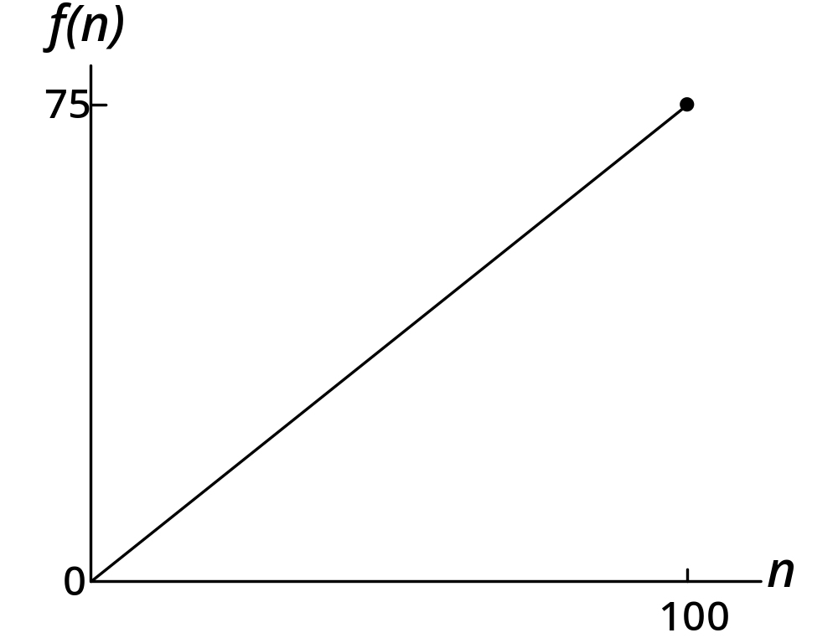
Figure 5-2: A graph of the average case performance of Linear Search
26年 11月 8日
Copyright © 1997 Oxford University Press
All Rights Reserved

Slide 35
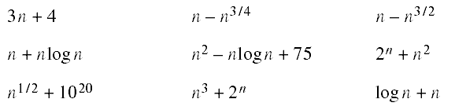
Exercise
  5-3 For the following formulas, identify the high-order term and indicate the order of each using big-O notation.
26年 11月 8日
Copyright © 1997 Oxford University Press
All Rights Reserved

Slide 36
Binary Search
Sorted items
compare a key with the middle item
if key > that of middle, search upper half
else, search lower half.
26年 11月 8日
Copyright © 1997 Oxford University Press
All Rights Reserved

Slide 37
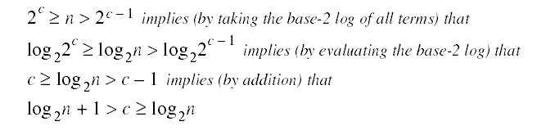
Equation 5-2
26年 11月 8日
Copyright © 1997 Oxford University Press
All Rights Reserved

Slide 38
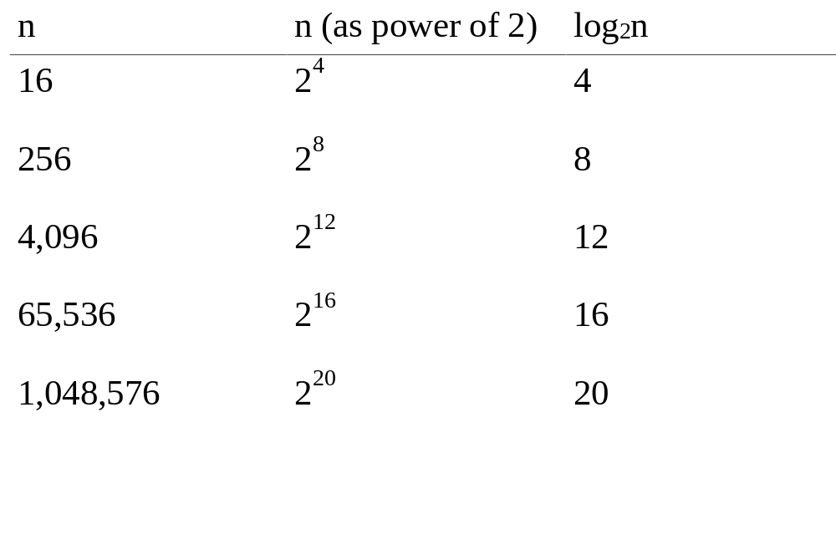
Table 5-1: The growth of the base-2 log function
26年 11月 8日
Copyright © 1997 Oxford University Press
All Rights Reserved

Slide 39
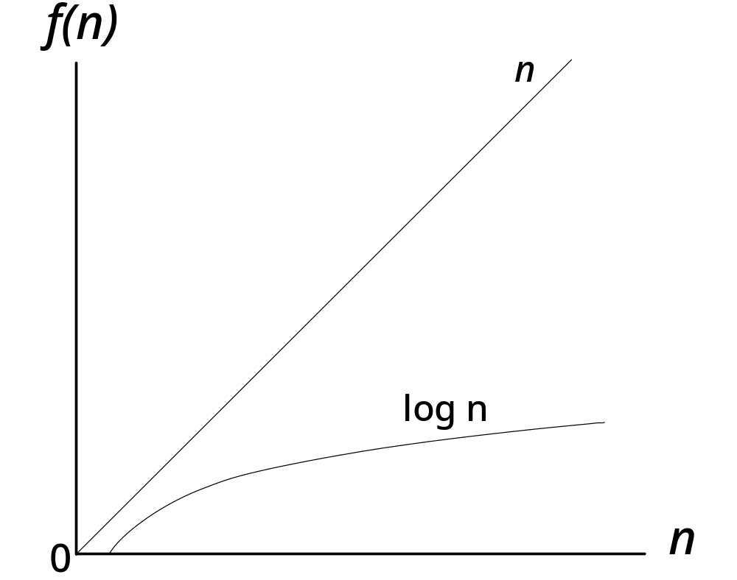
Graph illustrating relative growth of linear and logarithmic functions
26年 11月 8日
Copyright © 1997 Oxford University Press
All Rights Reserved

Slide 40
Code Example 5-2: Defective Binary Search
// cx5-2.cpp
// Code Example 5-2: Defective Binary Search -- Do Not Use!
int binarySearch(int a[], int n, int target)
{
// Precondition: array a is sorted in ascending order from a[0] to a[n-1]
int first(0);
int last(n - 1);
int mid;
while (first <= last) {
mid = (first + last)/2;
if (target == a[mid])
return mid;
26年 11月 8日
Copyright © 1997 Oxford University Press
All Rights Reserved

Slide 41
Code Example 5-2: Defective Binary Search
else if (target < a[mid])
last = mid;
else // must be that target > a[mid]
first = mid;
}
return -1; // use -1 to indicate item not found
}
26年 11月 8日
Copyright © 1997 Oxford University Press
All Rights Reserved

Slide 42
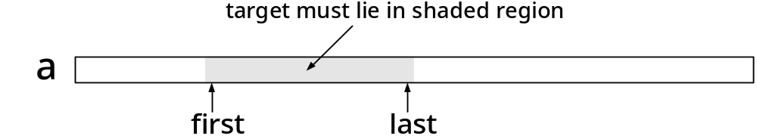
Figure 5-4
Illustrated Invariant for Binary Search
26年 11月 8日
Copyright © 1997 Oxford University Press
All Rights Reserved

Slide 43
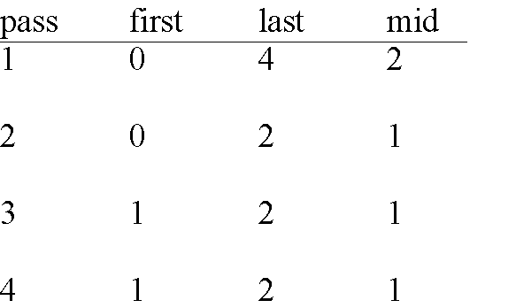
Table 5-2: Trace of Code Example 5-2 on Page 99
search 5 in {2,3,7,9,13}
26年 11月 8日
Copyright © 1997 Oxford University Press
All Rights Reserved

Slide 44
Code Example 5-3: Verified binary Search
int binarySearch(int a[], int n, int target)
{
// Precondition: array a is sorted in ascending order from a[0] to a[n-1]
int first(0);
int last(n - 1);
int mid;
while (first <= last) {
// Invariant: if target in a, then a[first] <= target <= a[last]
mid = (first + last)/2;
26年 11月 8日
Copyright © 1997 Oxford University Press
All Rights Reserved

Slide 45
Code Example 5-3: Verified binary Search
if (target == a[mid])
return mid;
else if (target < a[mid])
last = mid - 1;
else // must be that target > a[mid]
first = mid + 1;
}
return -1; //use -1 to indicate item not found
}
26年 11月 8日
Copyright © 1997 Oxford University Press
All Rights Reserved

Slide 46
Binary search vs. linear search
Binary search
  requires a sorted array
  Good for large list
  sometimes impractical to jump to middle of the list
Linear seach
  uses any array
  Good enough for short list
26年 11月 8日
Copyright © 1997 Oxford University Press
All Rights Reserved

Slide 47
Selection sort
Select largest items from the unsorted array
Move it to the sorted array
Done if all items are moved
26年 11月 8日
Copyright © 1997 Oxford University Press
All Rights Reserved

Slide 48
Algorithm 5-2:selection of max element
Max position <-- position of first item in the array
current position <-- position of second item in the array
while current position is not past the end of the array do
if item in current position is greater than item in max position then
max position <-- current position
current position <-- position of next item in the list
return max position
26年 11月 8日
Copyright © 1997 Oxford University Press
All Rights Reserved

Slide 49
Code Example 5-4: The maxSelect function
// cx5-4.cpp
// Code Example 5-4: Max Select function
int maxSelect(int a[], int n)
{
int maxPos(0), currentPos(1);
while (currentPos < n) {
// Invariant: a[maxPos] >= a[0] ... a[currentPos-1]
if (a[currentPos] > a[maxPos])
maxPos = currentPos;
currentPos++;
}
return maxPos;
}
26年 11月 8日
Copyright © 1997 Oxford University Press
All Rights Reserved

Slide 50
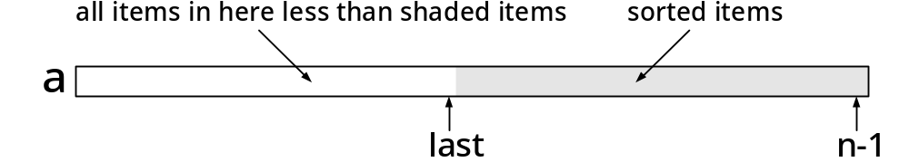
Figure 5-5: The operation of Selection Sort
26年 11月 8日
Copyright © 1997 Oxford University Press
All Rights Reserved

Slide 51
Code Example 5-5: Selection Sort
// cx5-5.cpp
// Code Example 5-5: Selection Sort
void swapElements(int a[], int maxPos, int last); // see Exercise 5-12
int maxSelect(int a[], int n); // see cx5-4.cpp
void selectionSort(int a[], int n)
{
int last(n-1);
int maxPos;
26年 11月 8日
Copyright © 1997 Oxford University Press
All Rights Reserved

Slide 52
Code Example 5-5: Selection Sort
while (last > 0) {
// invariant: a[last+1] ... a[n-1] is sorted &&
// everything in a[0] ... a[last] <= everything in a[last+1] ... a[n-1]
maxPos = maxSelect(a, last+1); // last+1 is length from 0 to last
swapElements(a, maxPos, last);
last--;
}
}
26年 11月 8日
Copyright © 1997 Oxford University Press
All Rights Reserved

Slide 53


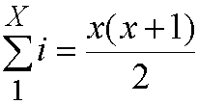

Analysis of selection sort
=
Since
26年 11月 8日
Copyright © 1997 Oxford University Press
All Rights Reserved

Slide 54
Bubble sort
Moves items one at a time into a sorted region of the array
Sorting process looks like popping up of bubbles in water
At each phase, the unsorted array is passed through, comparing adjacent pairs of items, and exchanging the positions of the items in pairs that are out of order
26年 11月 8日
Copyright © 1997 Oxford University Press
All Rights Reserved

Slide 55
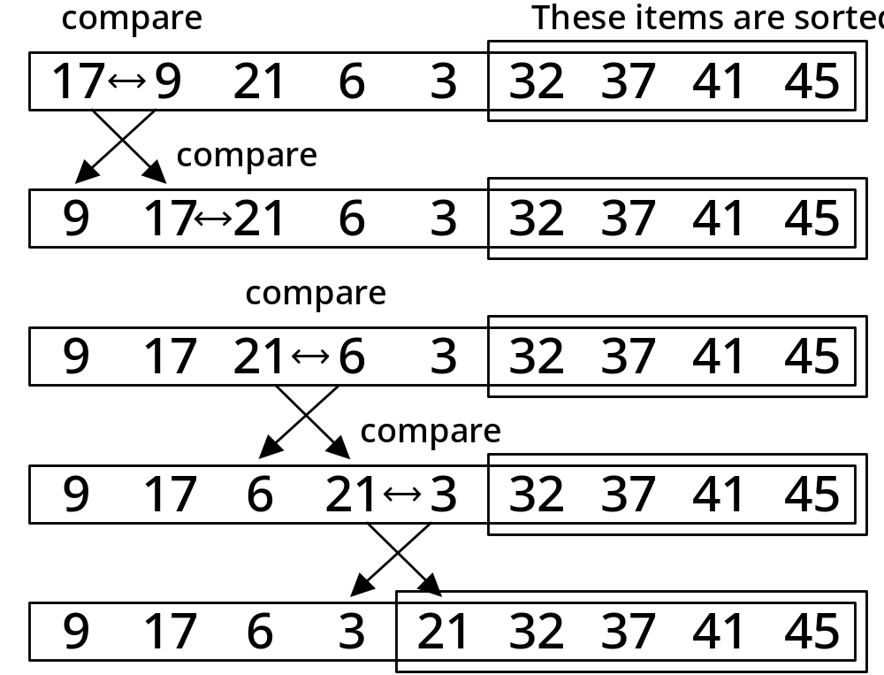
Example of one phase of Bubble Sort
26年 11月 8日
Copyright © 1997 Oxford University Press
All Rights Reserved

Slide 56
Code Example 5-6: bubbleSortPhase
// cx5-6.cpp
// Code Example 5-6: Bubble Sort Phase
void swapElements(int a[], int maxPos, int last); // see Exercise 5-12
void bubbleSortPhase(int a[], int last)
{
// Precondition: a is an array indexed from a[0] to a[last]
// Move the largest element between a[0] and a[last] into a[last],
// by swapping out of order pairs
int pos;
26年 11月 8日
Copyright © 1997 Oxford University Press
All Rights Reserved

Slide 57
Code Example 5-6: bubbleSortPhase
for (pos = 0; pos < last - 1; pos++)
if (a[pos] > a[pos+1]) {
swapElements(a, pos, pos+1);
}
// Postconditions: a[0] ... a[last] contain the same elements,
// possibly reordered; a[last] >= a[0] ... a[last-1]
}
26年 11月 8日
Copyright © 1997 Oxford University Press
All Rights Reserved

Slide 58
Code Example 5-7: Bubble Sort
// cx5-7.cpp
// Code Example 5-7: Bubble Sort
void bubbleSortPhase(int a[], int last); // see cx5-6.cpp
void bubbleSort(int a[], int n)
{
// Precondition: a is an array indexed from a[0] to a[n-1]
int i;
for (i = n - 1; i > 0; i--)
bubbleSortPhase(a, i);
// Postcondition: a is sorted
}
26年 11月 8日
Copyright © 1997 Oxford University Press
All Rights Reserved

Slide 59

Equation 5-7
26年 11月 8日
Copyright © 1997 Oxford University Press
All Rights Reserved

Slide 60
실습예제
Selection sort 를 increasing order 가 되게 구현하시오. 현재 교과서에 있는 구현은 decreasing order 이다.
26年 11月 8日
Copyright © 1997 Oxford University Press
All Rights Reserved

